Slide 1

Indian Institute of Space Science and Technology AE-224 MACHINING AND PRECISION MANUFACTURING
Task 1 : Designing and Manufacturing of a Mechanical Housing
Presented by −
Chinmay Gourkhede
SC19B012

Slide 2
Contents:
Raw Material Selection
Finished Product
Fabrication of Bottom
Fabrication of Top
Assembly
Measuring Methods for Verification

Slide 3
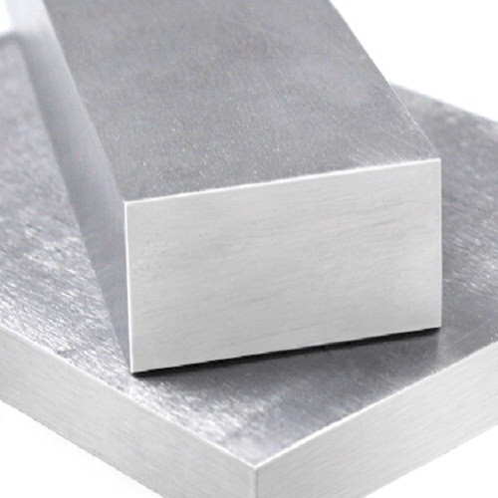
Raw Material : Aluminium
Aluminium has high strength-to-weight ratio which varies from 0.7 – 1.8
It is Easily Available and Machinable
Being a light weight metal , Aluminium is widely used in Aviation Industry
The Dimensions of the Metal Blank provided is 250x250x60 mm , 2 nos.

Slide 4
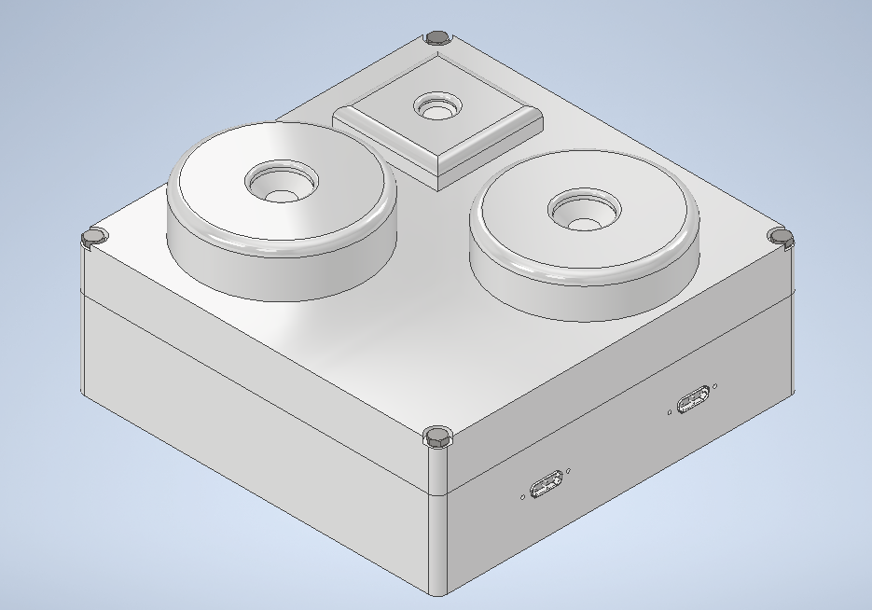
Finished Product :
Dimensions : 200 ± 0.1mm x 200 ± 0.1mm x 100 ± 0.1mm
Overall Weight : 2.485 + 0.300 =2.785kg

Slide 5
Fabrication of Bottom:

Slide 6
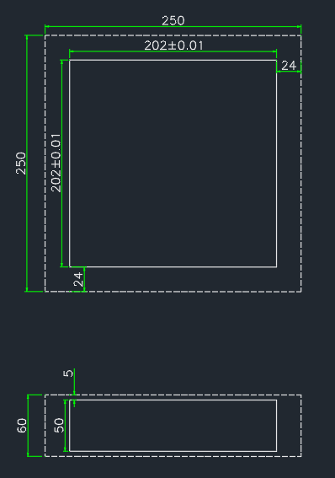
1. Face & End Milling
to reduce plate dimension from 250x250x60 to 202x202x50
Milling Tool required of dim Ø50mm
Extra 2 mm is for Grinding 1 mm from each side for a better finish.

Slide 7
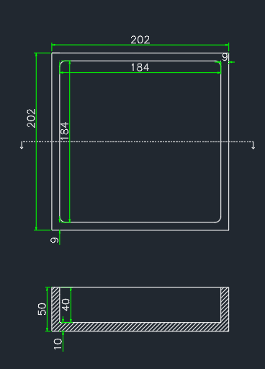
2. Square Pocket Milling
Starting 11 mm from the edges to make a cavity of dimension 184x184x40 mm.
Milling Tool Ø30-50mm

Slide 8

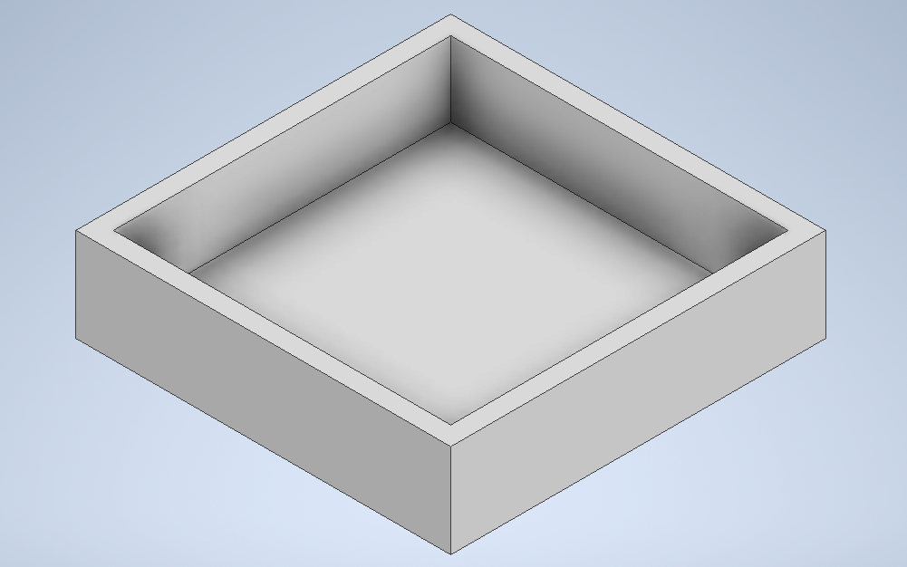

Slide 9
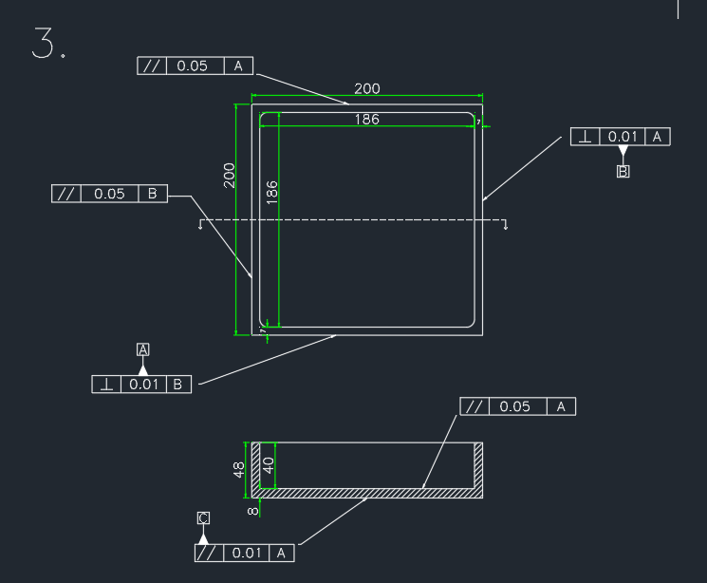
3. Grinding
With the Help of Grinding wheel , we remove the additional 1 mm from the work-piece
Grinding wheel , Open structure with Soft wheel

Slide 10
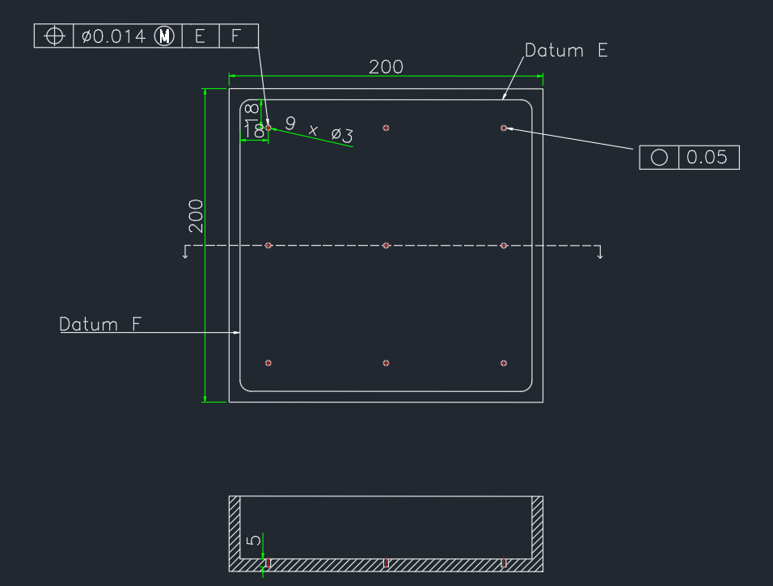
4a.Drilling
Performing Drilling operation with the help of a Drilling Machine to construct blind drill holes inside the cavity , on the base
Dimension – 9 x (M3 , 5mm)
Drill bit Ø3mm
These drill holes will help to secure the circuit board 10mm above the base.
A Jig can be used for convenience in drilling

Slide 11
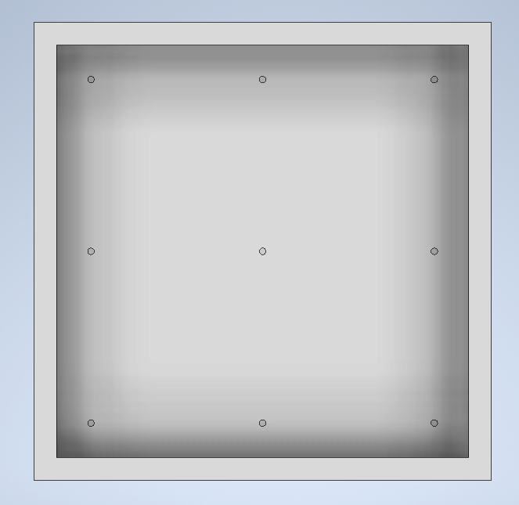
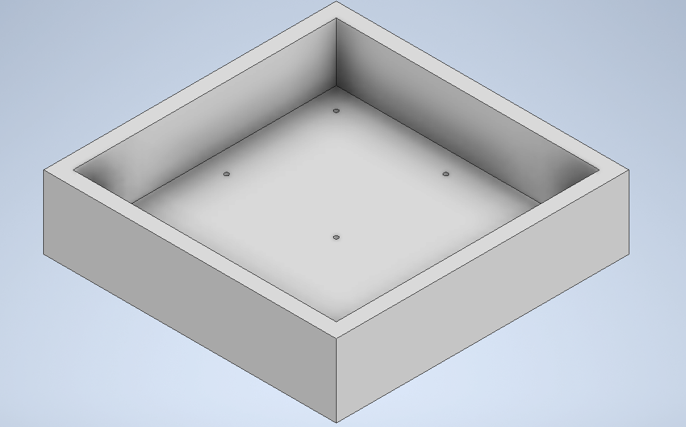

Slide 12
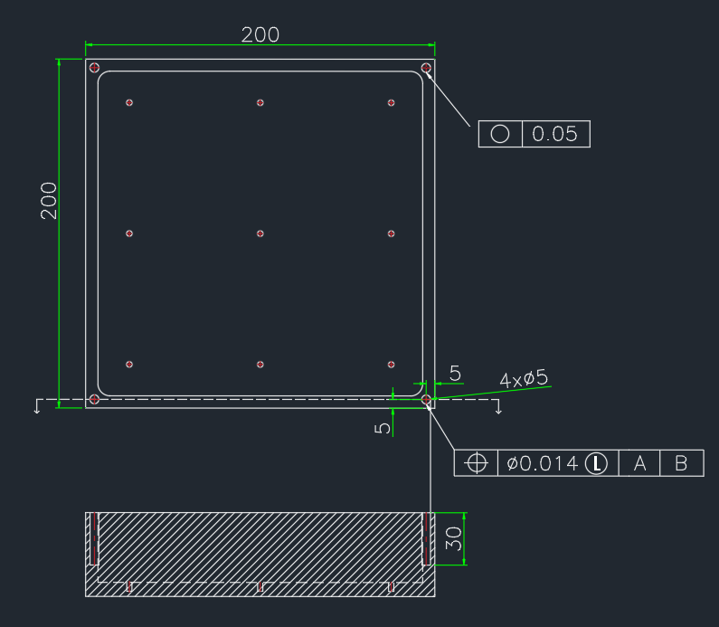
4b.Drilling
Using Drilling Operation to construct 4 blind drill holes at the corners of the wall on the Top.
Dimensions : Ø5mm , 30mm
These holes will be useful to attach the Top to the Bottom
Drill bit Ø5mm

Slide 13
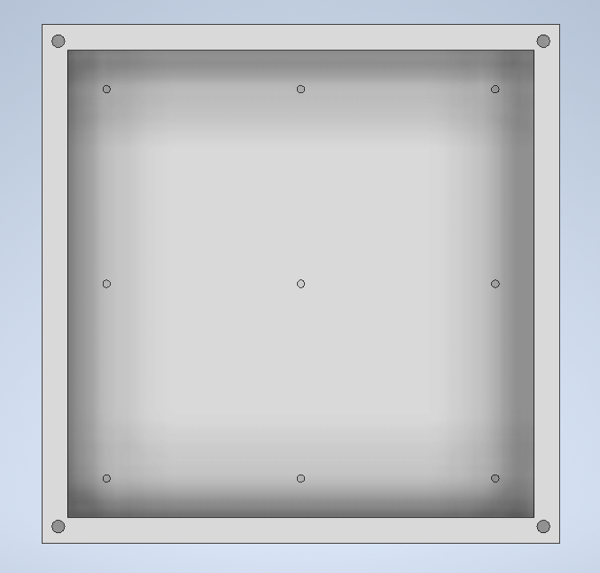
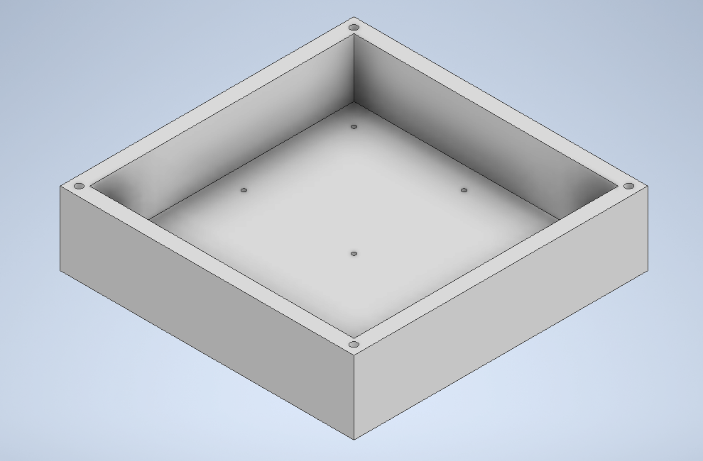

Slide 14
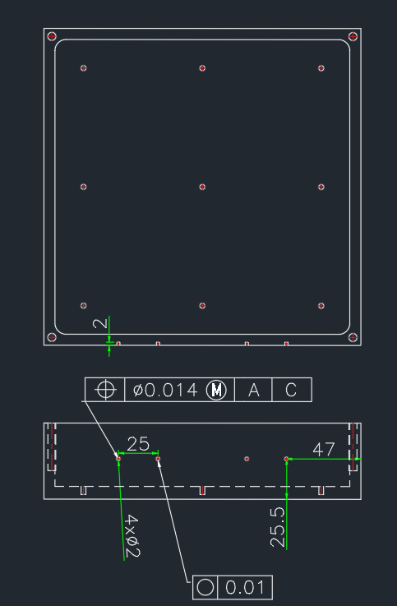
4c.Drilling
Drilling 4 blind holes on any one of the outer of the walls. This face will be called the ‘ Front Face ’ of the box.
They will be useful to attach the D-Pin connectors to the interior of the ‘Front Wall ’
They will also help to use Wire EDM to make slot for D-Pin.
Dimension:4 x ( Ø2 mm , 2mm )
Drill bit Ø2mm

Slide 15
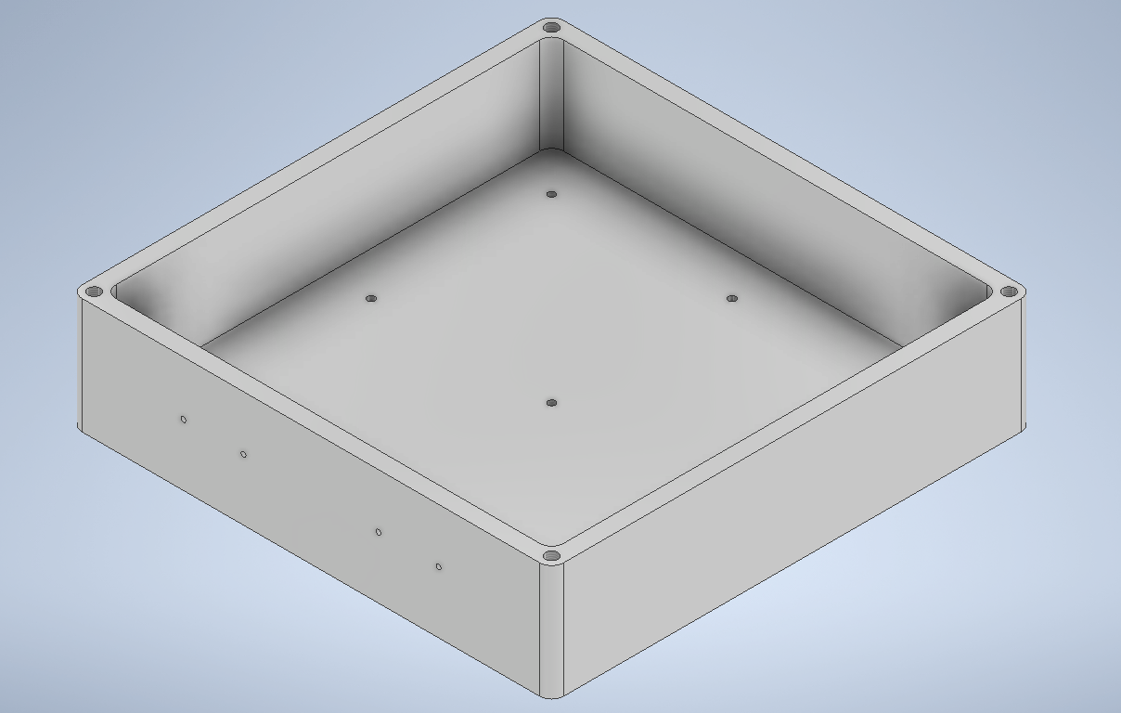
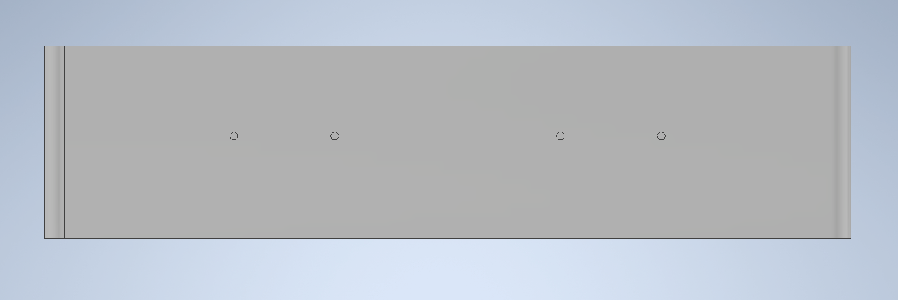

Slide 16
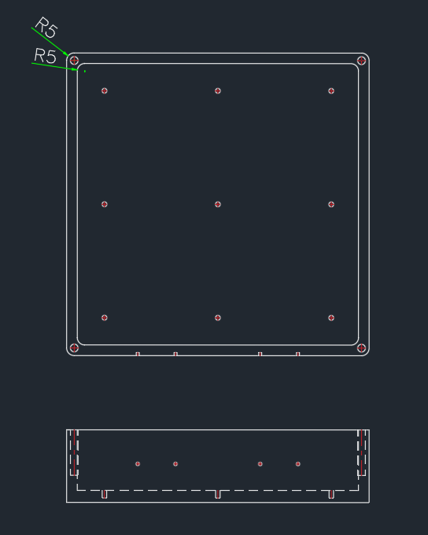
5.Fillet
Adding fillets on Radius 5mm on the interior and Exterior corners of the Bottom Assembly
Fillets help in reducing stress concentration as they can distribute stress uniformly

Slide 17
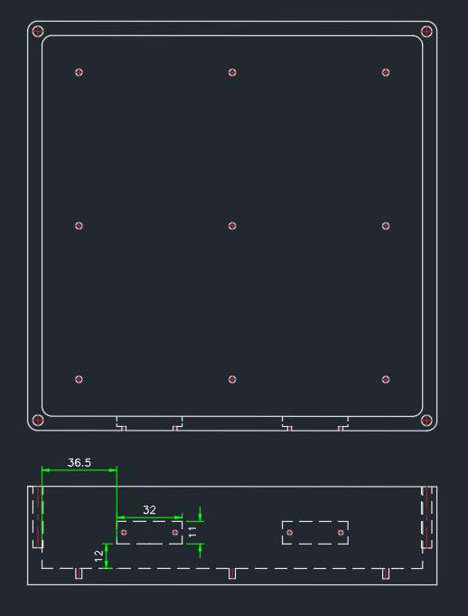
6. Square Pocket Milling
Constructing a rectangular cavity inside the front wall to fit the D-Pins
Dimension 32x11 mm
Milling tool Ø5mm

Slide 18
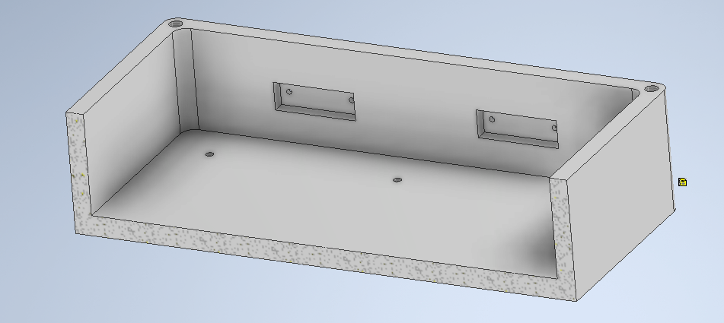
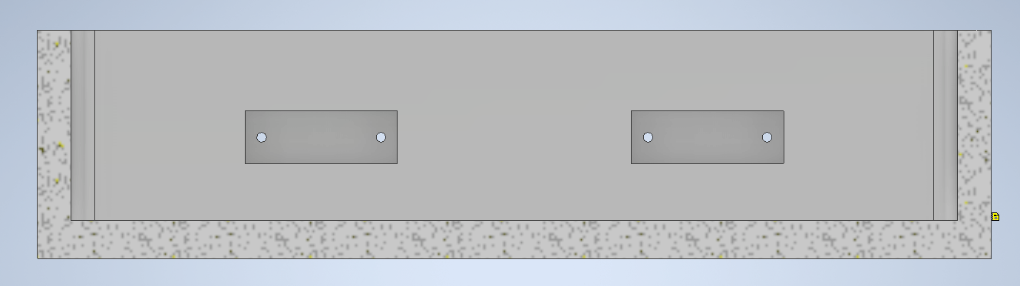

Slide 19
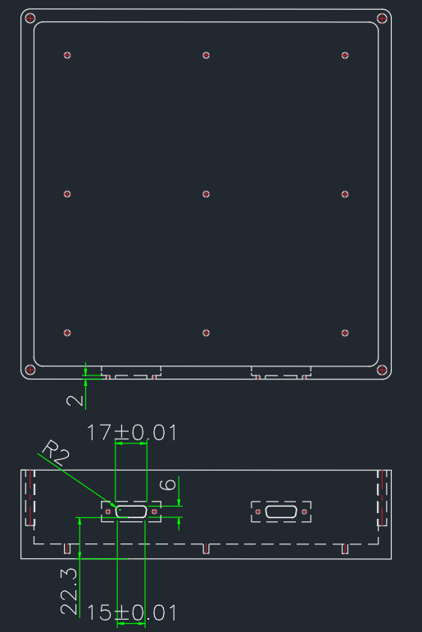
7. Wire EDM
Slot for D pin to be exposed out.
Using the Drill holes

Slide 20
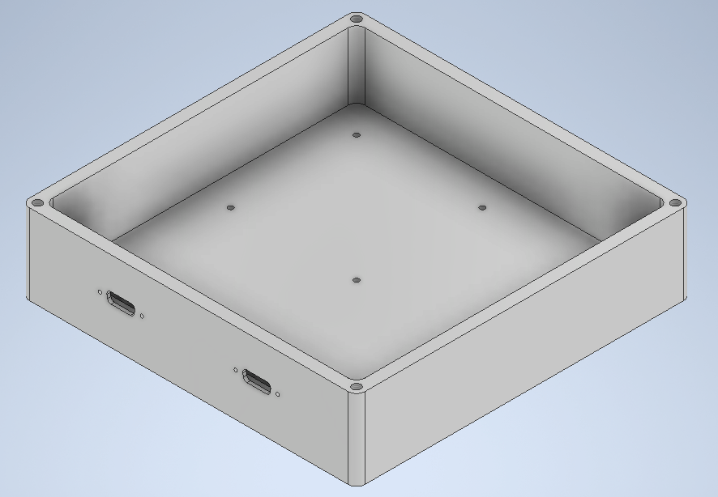
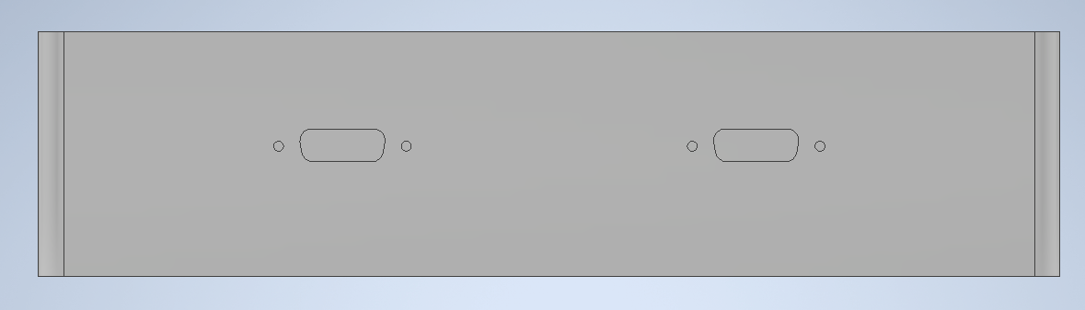
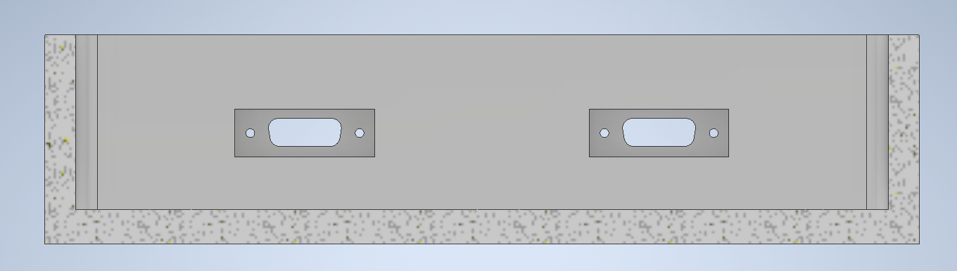

Slide 21
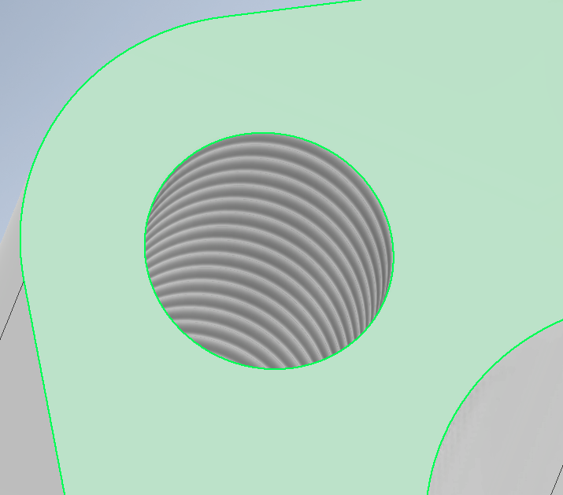
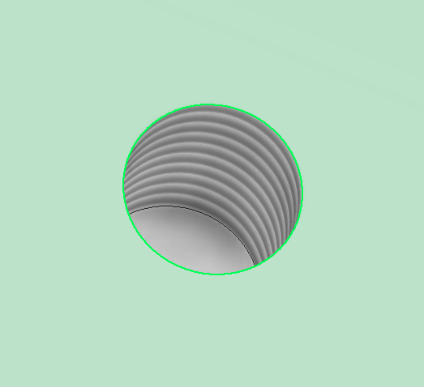
8. Tapping
To add internal threads to the drilled holes on the base and on the Corners of the Work piece

Slide 22
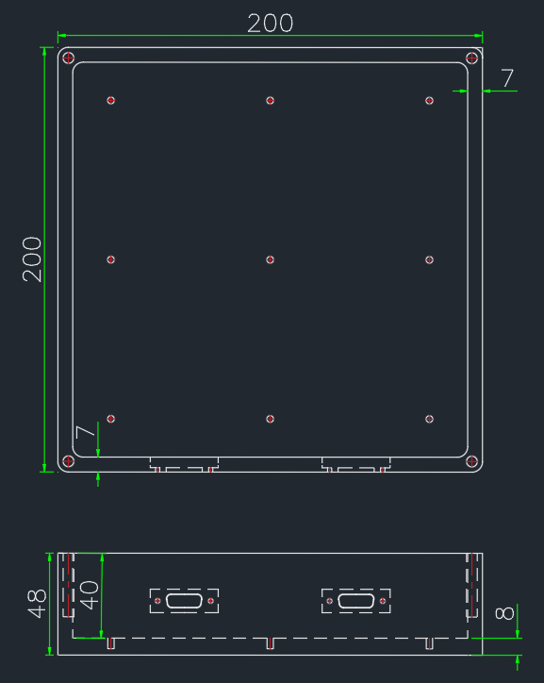
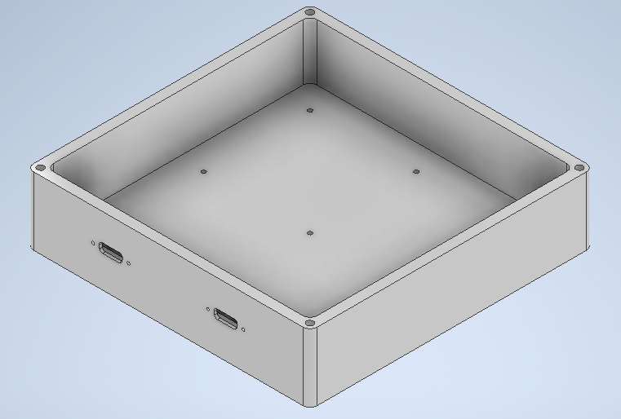
Final Bottom

Slide 23
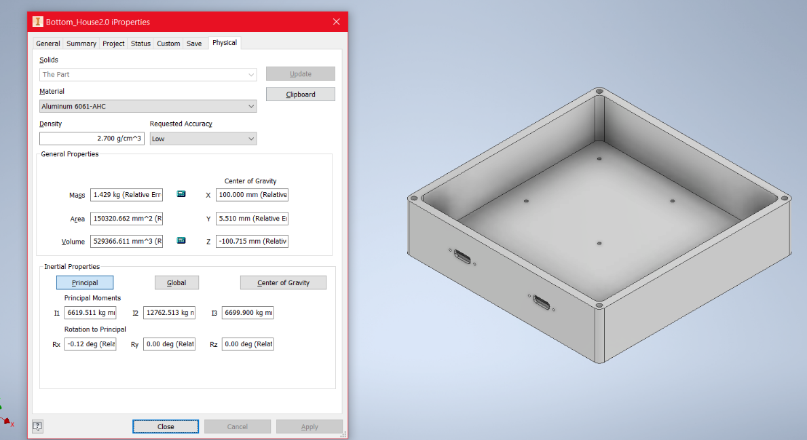
Weight of Bottom
Mass = 1.429kg

Slide 24
Fabrication of Top:

Slide 25
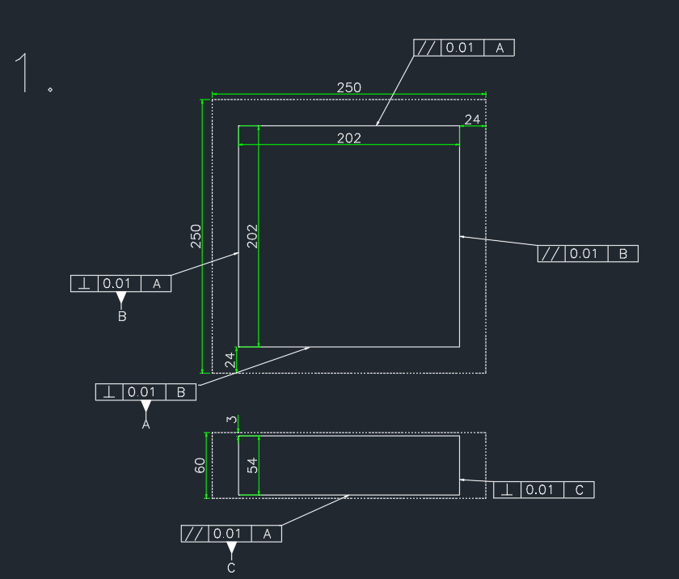
1. Face Milling
End milling to reduce the dimension of the blank from 250x250x60 mm to 202x202x54 mm
Milling tool of dim Ø50mm
Extra 2mm for grinding

Slide 26
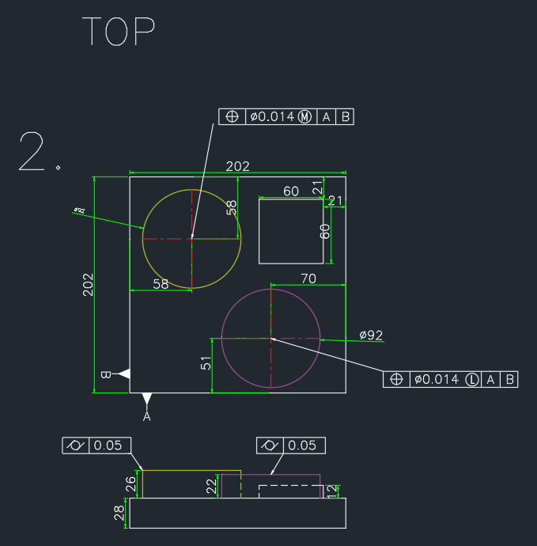
2a. End Milling
End milling on Top face to obtain Required profile.
Milling tool of dim Ø30mm and Ø10mm

Slide 27
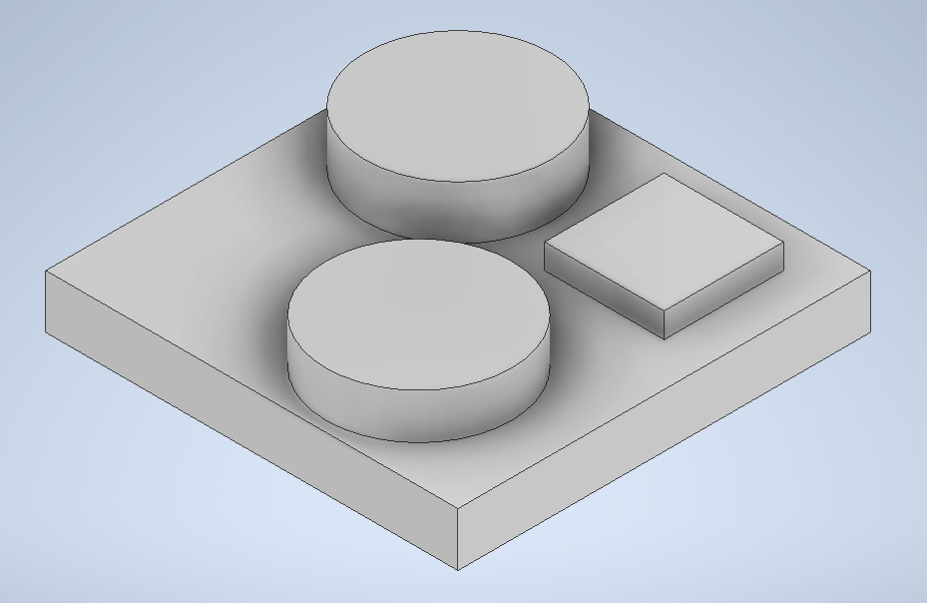

Slide 28
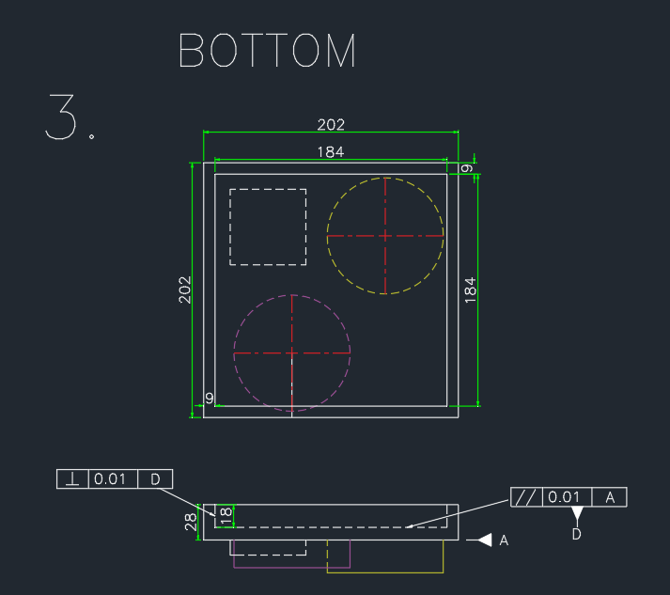
2b.End Milling
End milling on the bottom surface to create a cavity of dimension 184x184x18mm
Mill tool Ø30-50mm

Slide 29
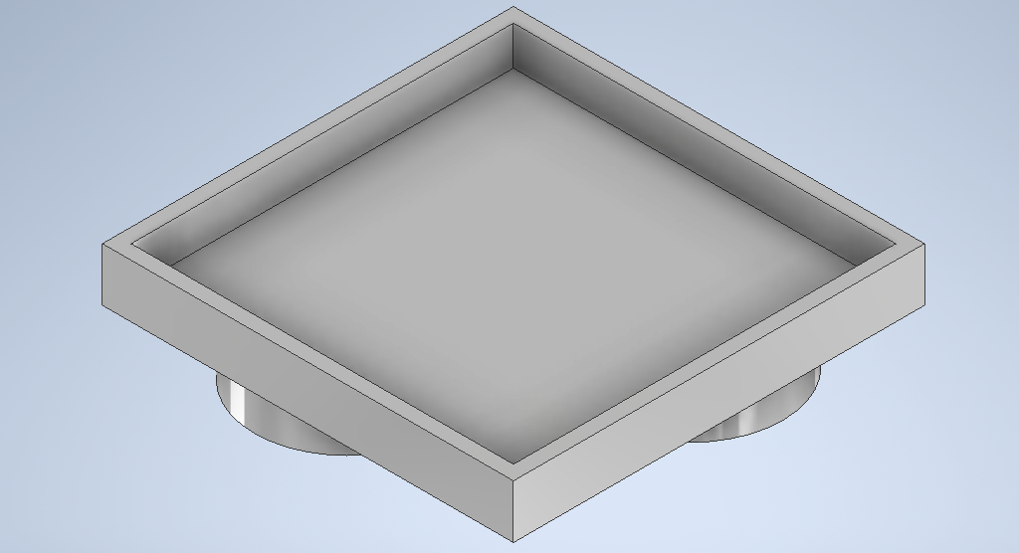

Slide 30
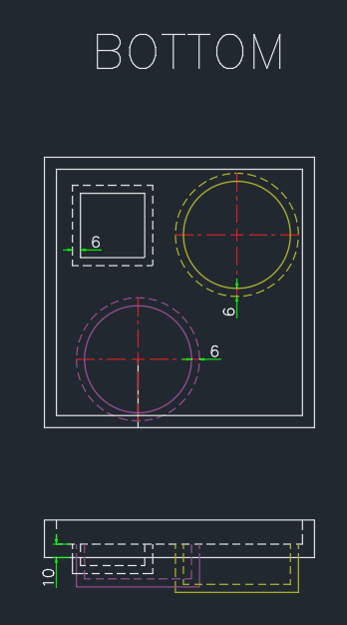
2c. End milling
using end mill to create holes for the Sensor 1 , 2 and 3.
Milling tool , Ø30mm

Slide 31
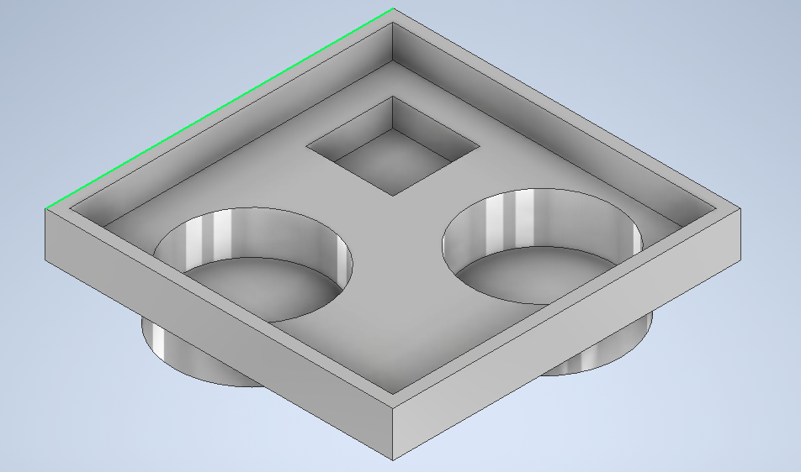

Slide 32
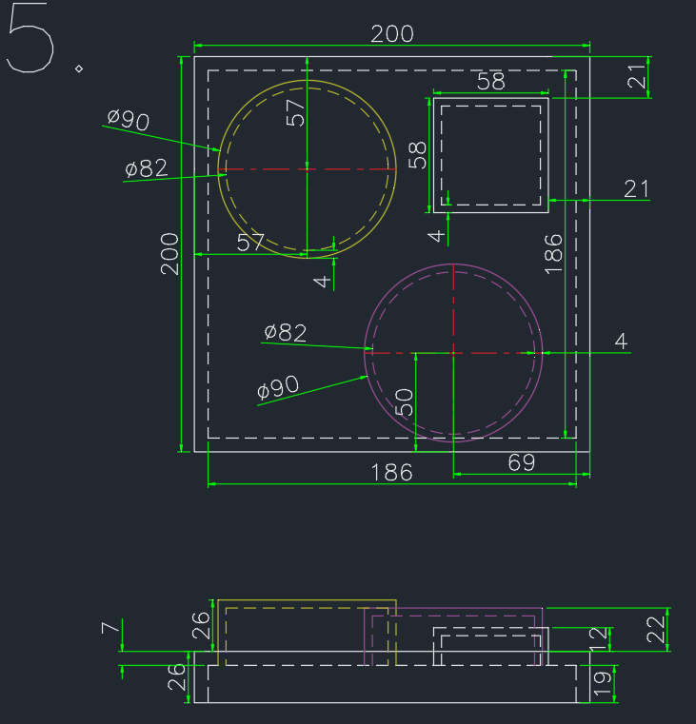
3.Grinding
Grinding the extra 1mm from all the faces for better surface finish
Grinding wheel , Open structure with Soft wheel

Slide 33
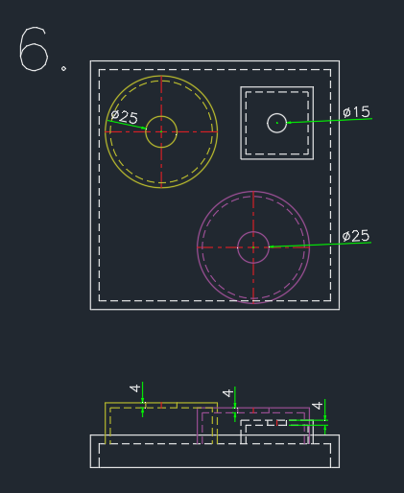
4.Trespanning
To create opening on the top face of the respective cylindrical holes of the sensors
Tool with Ø25 and Ø15mm

Slide 34
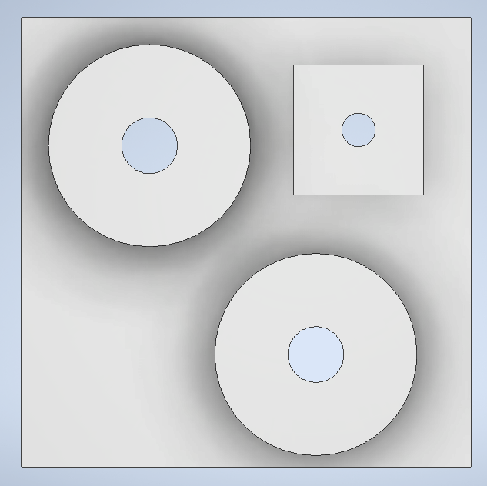
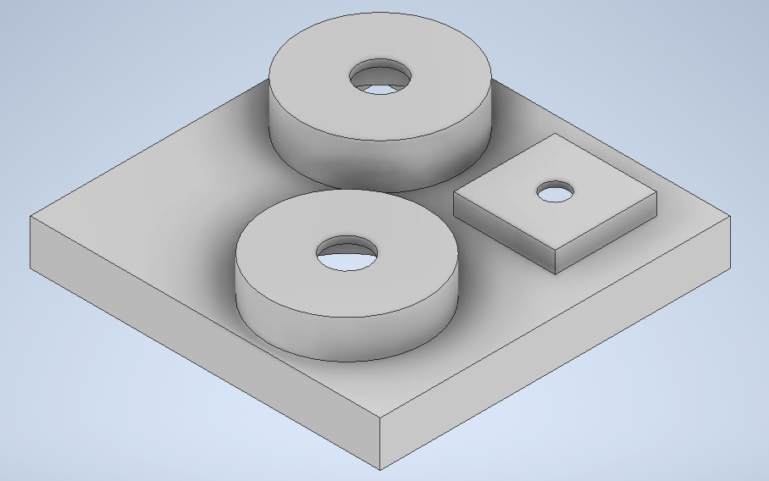

Slide 35
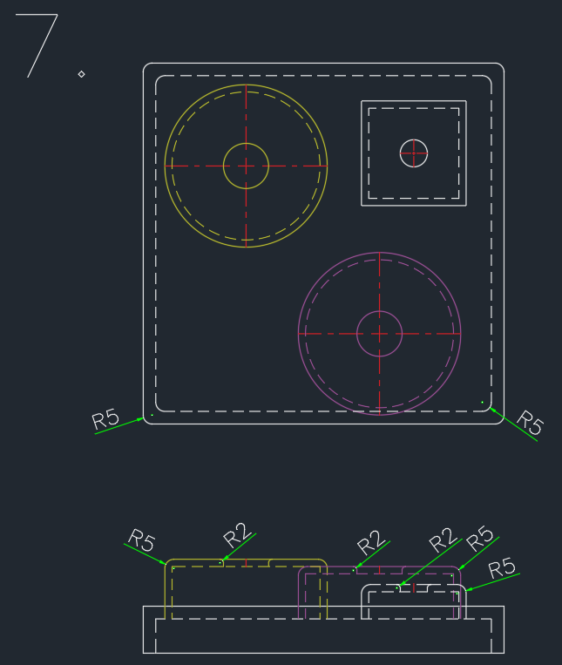
5. Fillet
Adding 5mm fillet to the interior and exterior corners of the Work piece and to the edges of the Cylinders
2mm Fillet on the holes of the Cylinder

Slide 36
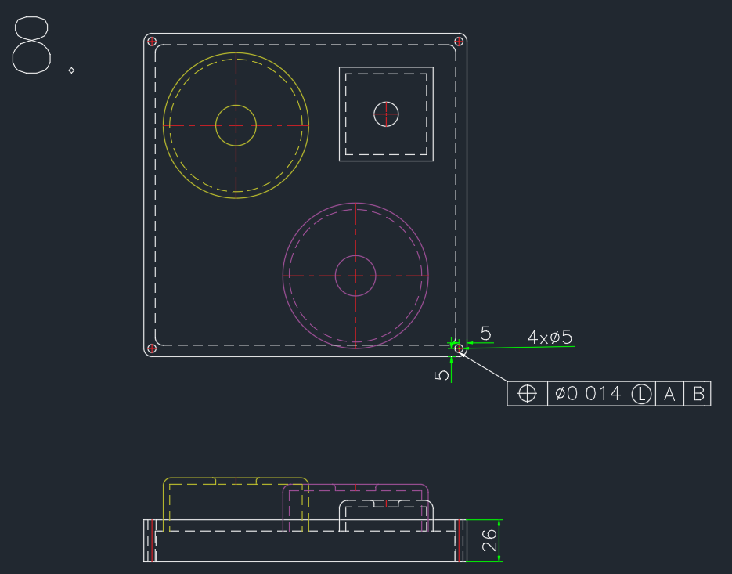
6.Drilling
Drilling holes at the corner of the Work piece with the help of a Drilling Machine
Dimensions : 4 x ( Ø5mm , 26mm )
Drill bit Ø5mm

Slide 37
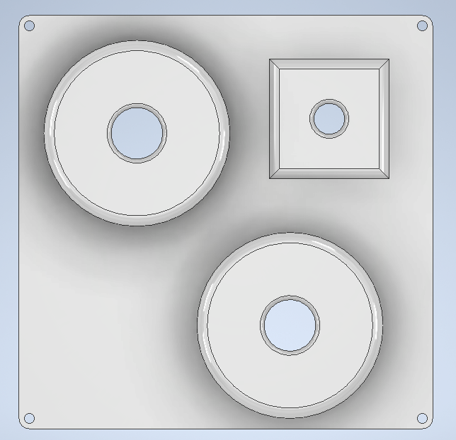
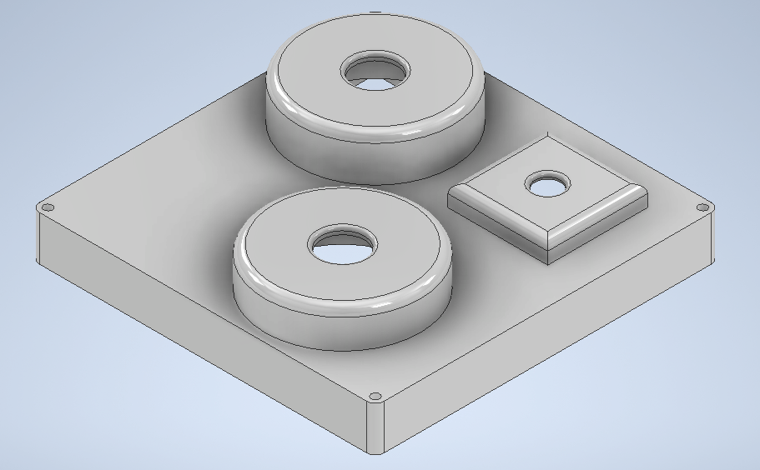

Slide 38
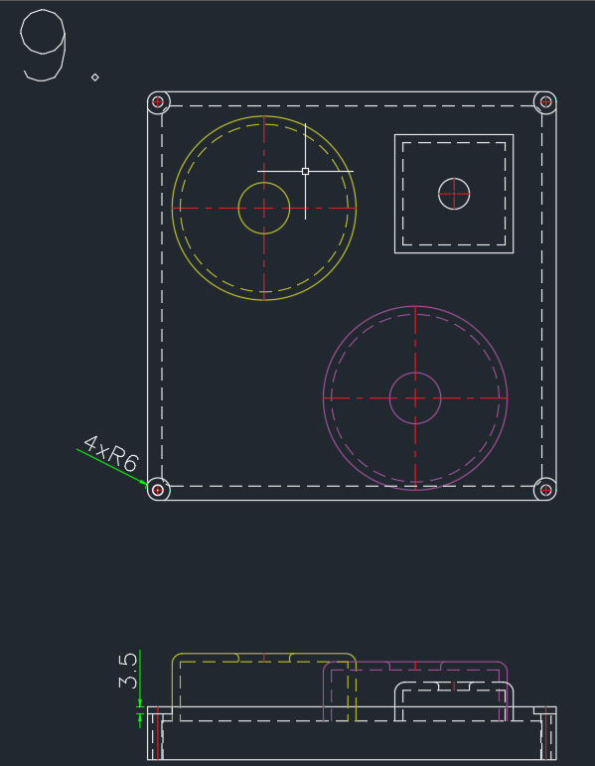
7. Counter-boring
Counter-Boring 3.5mm on the drilled holes
Counterbore with Ø12mm

Slide 39
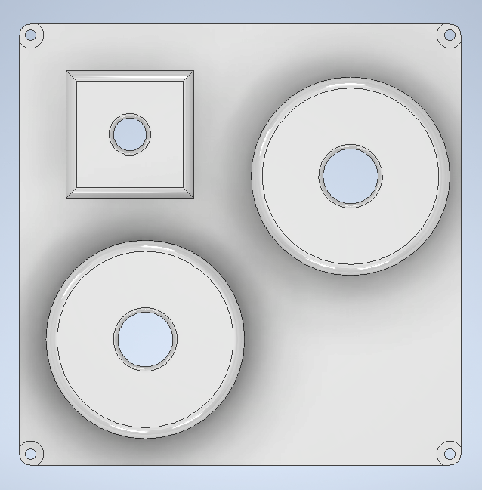
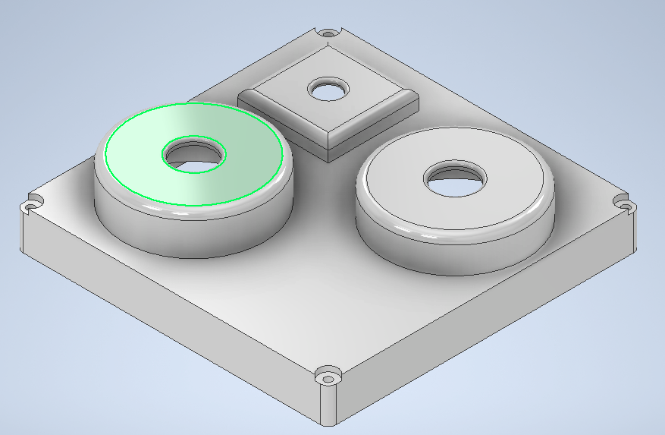

Slide 40
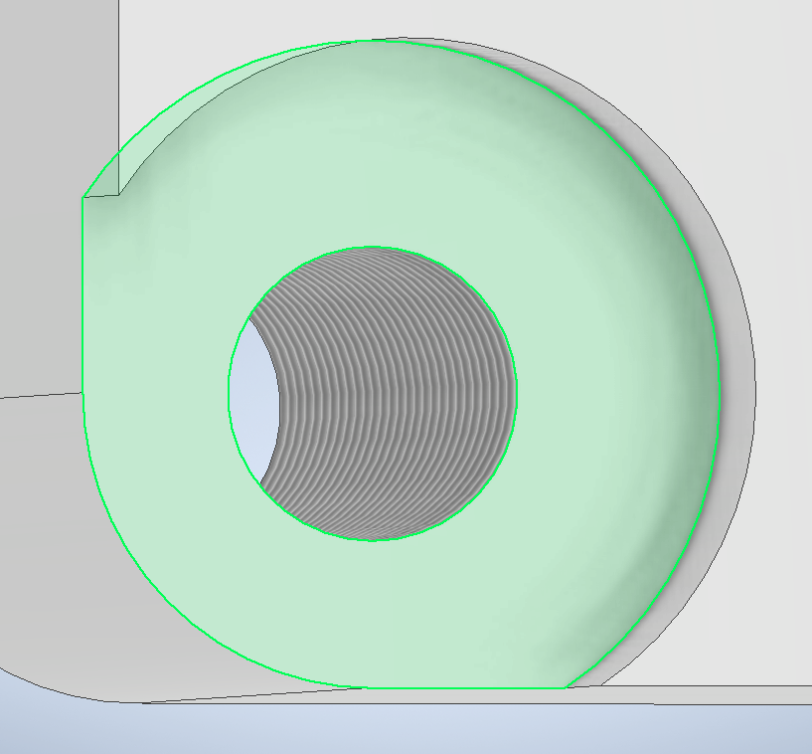
8.Tapping
To add Internal threads to the Drilled Holes

Slide 41
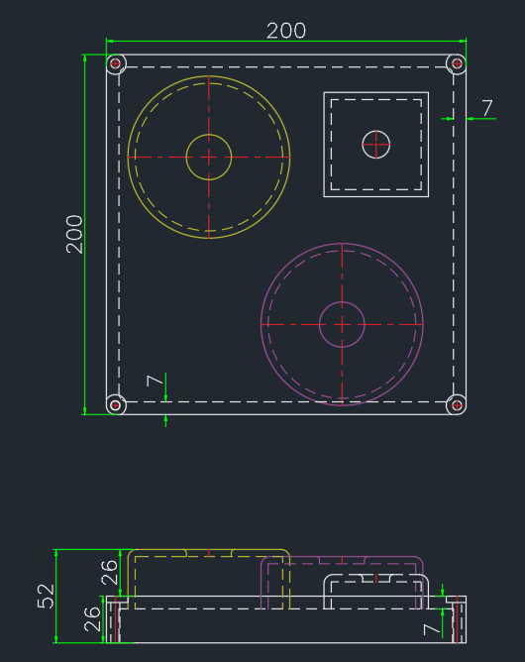
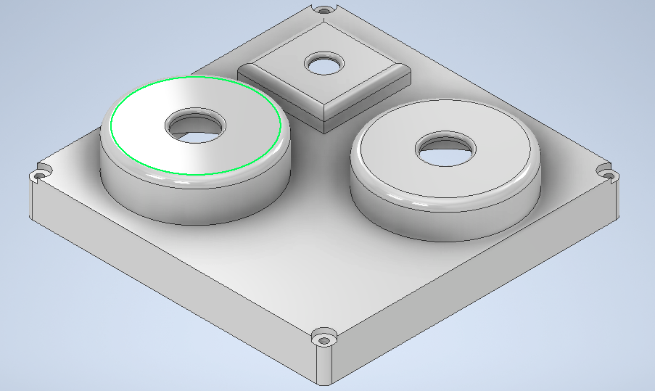
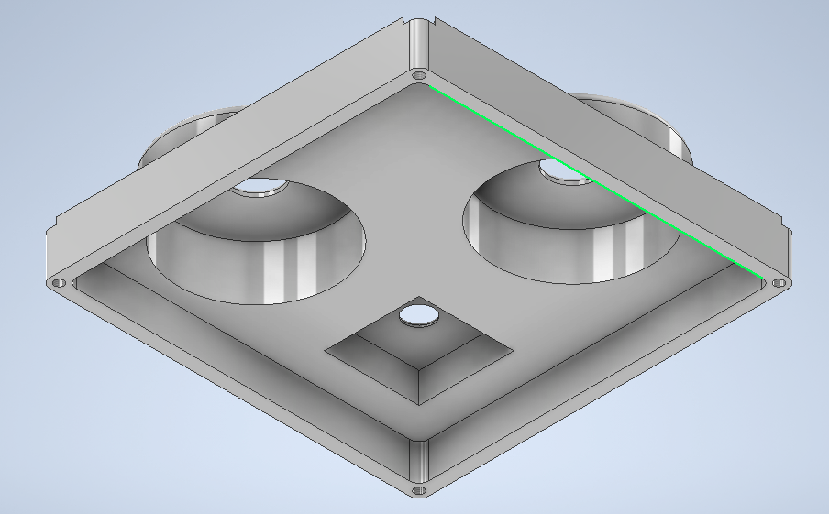
Final Top

Slide 42

Weight of Top
Mass = 1.056 kg

Slide 43
Assembly:

Slide 44

1. Insertion of Circuit Board(Sensor 4 in Documents) inside the Bottom Housing.

Slide 45


2. Attaching the Circuit Board 10mm above the Base with the help of M3x30mm screws. The D-Pins automatically fit in the slots and are Exposed out.

Slide 46

3. Inserting Sensor 1 in the Top Housing. The Sensor will be fixed with the help of L joints

Slide 47

4.Inserting Sensor 2 inside the Top Housing and attaching it with L Joints.

Slide 48

5. Inserting Sensor 3 into its Slot in Top Housing and screwing it to the top.

Slide 49
6. Fixing Top Housing to Bottom with M5x50 mm screws.

Slide 50
Measuring Methods for Verification

Slide 51
Perpendicularity : It can be Measured with Height Gauge and a Datum Perpendicular to the Gauge.
Parallelism : Dial Indicator mounted on a clamper.
Position Tolerance : Co-ordinate Measuring Machine ( CMM ) or Computer Vision System are appropriate instruments for obtaining positioning of various parts.
Circularity : A Dial Indicator mounted on a clamper with the subject revolving on V-Block.
Cylindricity : Similar Method to Circularity

Slide 52
End

